Slide 1




Vermont Enhanced Maple Sap Preheater Program
2017 Green Mountain Power CEED Proposal
Presented by
EnSave, Inc.

Slide 2
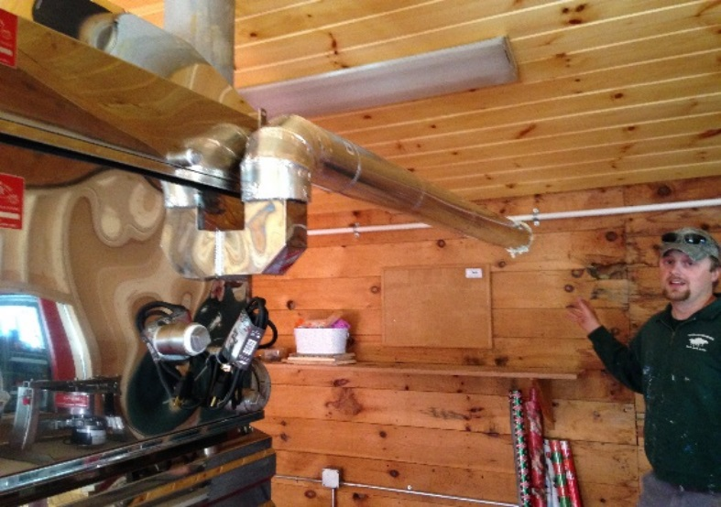
Program Overview
Vermont produces almost between 40-50% of all maple syrup in the United States
Production has been steadily rising; 2016 was a record year with almost 2 million gallons produced
Maple producers are looking for ways to reduce their fuel usage and increase operation efficiency
Notes:
Maple is a $226 million industry

Slide 3
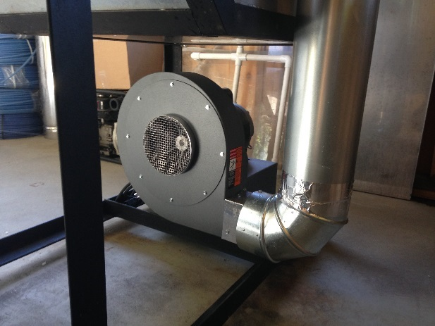
Technology Overview
Utilizes waste heat from flue pan to preheat incoming sap to approximately 200º F
Blower forces hot air through sap, concentrating it and increasing evaporation rate by 65-75%, reducing runtime
On average, this technology reduced fuel use by 40%
Also produces hot water as a byproduct
Notes:
Only operating approximately 100-200 hours per year

Slide 4
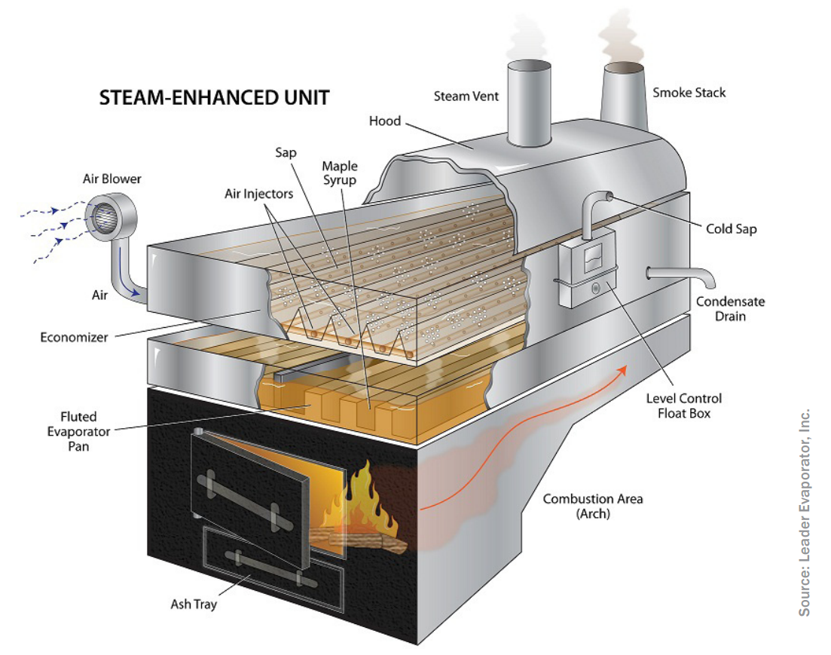
Enhanced Maple Sap Preheater
Notes:
Major brands include “Steam Away” (Leader), Sap Raider (Sunrise Metals)

Slide 5



2016 Program Overview
Current program has been extremely successful in assisting Vermonters reduce their energy use:
18 have been approved for installing an enhanced maple preheater
Program was fully subscribed within first 6 months
Provided many producers with Efficiency Vermont Rebate Forms
75% of applicants have used a Vermont manufacturer
Notes:
Maple is a $226 million industry

Slide 6
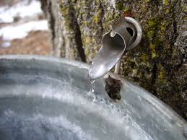
Current Program Savings
Participants with Reverse Osmosis (RO)
1,144 gallons of fuel oil saved (159 MMBtus/yr)
Participants without RO
543 gallons of fuel saved
(76 MMBtus/yr)
Total annual savings of 16,900 gallons of fuel oil
NSB ratio of 4.9
Notes:
Only operating approximately 100-200 hours per year

Slide 7
Proposed Program
Customer Segments Targeted
Maple syrup producers
Program Goals
Serve 26 medium and large sized maple syrup producers using fuel oil
Achieve approximately 26,652 gallons of annual fuel oil savings (3,717 MMBtus/year)
Program Cost and Net Societal Benefit
$467,360 including customer contributions and incentives ($234,000 in incentives and $47,200 in participant share)
NSB ratio of 4.0

Slide 8
Follow up Questions
Thank you!
Jessica Frank, Program Manager
jessicaf@ensave.com, (802) 434-1838
Kyle Clark, Director of Sustainability
kylec@ensave.com, (802) 434-1827

